Slide 1
Training Overview
Topics to be covered:
- Git
- GitHub
- Ansible
- Ansible Tower
- Terraform
- VS Code

Slide 2
Git
Version control basics:
- Repositories
- Commits
- Branching
- Merging

Slide 3
GitHub
Collaboration workflows:
- Pull Requests
- Issues
- Actions
- Repository Management

Slide 4
Ansible
Automation and configuration management:
Introduction Ansible
Deploying Ansible
Implementing Playbooks
Managing Variables and Facts
Implementing Task Control
Deploying Files to Managed Hosts
Managing Large Projects
Simplifying Playbook with Roles
Troubleshooting Ansible
Comprehensive Review

Slide 5
Ansible Tower
Features of Ansible Tower:
- Web UI
- Projects
- Job Templates
- Work Flow Job Templates
- Credentials
- Inventory
- Job Scheduling
- Role-based Access
- Logging

Slide 6
Terraform
Infrastructure as Code:
- What is terraform ?
- Providers
- Resources
- Variables
- Meta Arguments
- Backends
- outputs
- Modules
- State Management

Slide 7
VS Code Basics
Editor features:
- Extensions
- Debugging
- Source Control
- Integrated Terminal

Slide 8
Summary
Thankyou

Slide 9
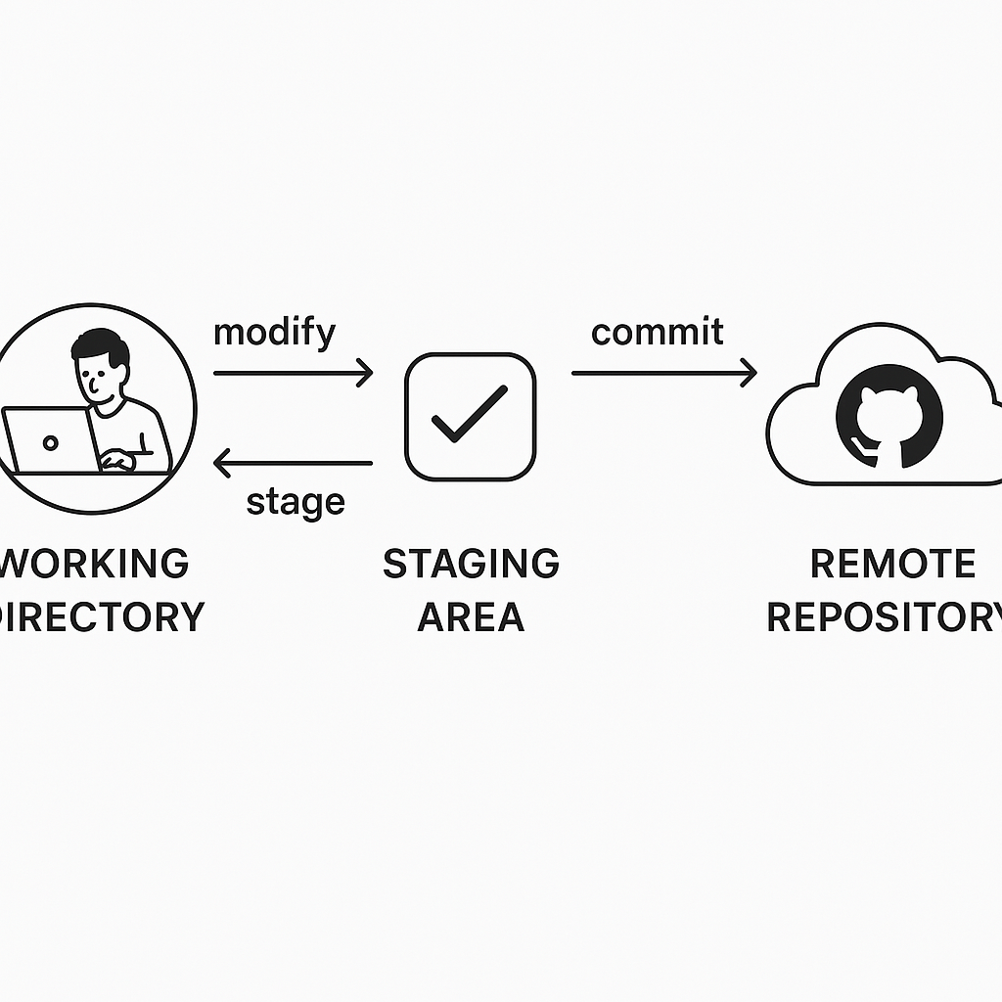
Git Workflow Diagram
A diagram illustrating the Git workflow: showing a developer making changes in a working directory, staging them, committing to a local repository, and pushing to a remote repository like GitHub. Include arrows and labels for each step.

